Slide 1



Music Machine Learning
0 – Introduction (AI)
Master ATIAM - Informatique
Philippe Esling (esling@ircam.fr)
Maître de conférences – UPMC
Equipe représentations musicales (IRCAM, Paris)

Slide 2
Artificial intelligence
Artificial intelligence ?
Requires to first understand what intelligence is !
Must have something to do with thinking
Thinking

Slide 3
Artificial intelligence
Artificial intelligence ?
Requires to first understand what intelligence is !
Must have something to do with thinking
But in a broader sense, might also be about perception and action
In terms of philosophy, we would talk about problems involving these
However, we try to understand the mechanisms of our thinking itself
So here, we seek models targeted at thinking, perception and actions
Thinking, perception and action

Slide 4
Artificial intelligence
Artificial intelligence ?
Requires to first understand what intelligence is !
Must have something to do with thinking
But in a broader sense, might also be about perception and action
In terms of philosophy, we would talk about problems involving these
However, we try to understand the mechanisms of our thinking itself
So here, we seek models targeted at thinking, perception and actions
Hence, here we will try to construct a model of thinking
This might even help you in understanding your own thinking process ☺
Models targeted at
Thinking, perception and action

Slide 5
Artificial intelligence
Thinking
Creation ex-nihilo can not really exist …
Intelligence: « the capacity to assemble two ideas that seemed heterogeneous »
« Man can only desire what he has already perceived »
William Blake
Models targeted at
Thinking, perception and action

Slide 6
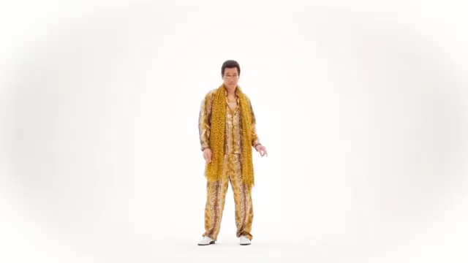
Artificial intelligence
Thinking
Creation ex-nihilo can not really exist …
Intelligence: « the capacity to assemble two ideas that seemed heterogeneous »
« Man can only desire what he has already perceived »
William Blake
Models targeted at
Thinking, perception and action

Slide 7
Artificial intelligence
Thinking
Creation ex-nihilo can not really exist …
Intelligence: « the capacity to assemble two ideas that seemed heterogeneous »
We exist (morphologically) since ~200 kYears, and around ~50 kY …
So thinking is finding similarity, discriminating and seeing common patterns
NB: Frames of Mind: the Theory of multiple intelligence – Howard Gardner
(logico-mathematic, spatial, inter-personal, corporal, linguistic, intra-personnal, musical, ecologist, existential)
In order to have a model, you need a representation
« Man can only desire what he has already perceived »
William Blake
« Take two concepts and create a third one without impairing the two first »
Noam Chomsky
Models targeted at
Thinking, perception and action

Slide 8
Artificial intelligence
Thinking
Creation ex-nihilo can not really exist …
Intelligence: « the capacity to assemble two ideas that seemed heterogeneous »
We exist (morphologically) since ~200 kYears, and around ~50 kY …
So thinking is finding similarity, discriminating and seeing common patterns
NB: Frames of Mind: the Theory of multiple intelligence – Howard Gardner
(logico-mathematic, spatial, inter-personal, corporal, linguistic, intra-personnal, musical, ecologist, existential)
In order to have a model, you need a representation
A representation that supports a model that allows to understand thinking
« Man can only desire what he has already perceived »
William Blake
« Take two concepts and create a third one without impairing the two first »
Noam Chomsky
Representations supporting
Models targeted at
Thinking, perception and action

Slide 9
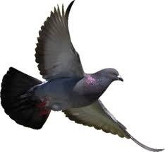
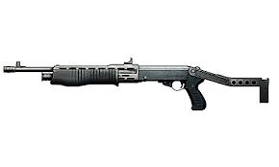
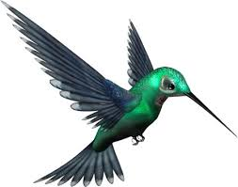
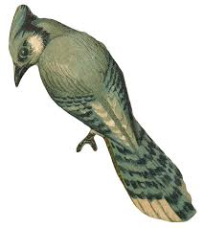
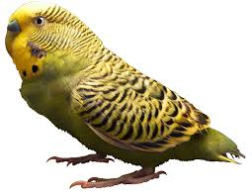
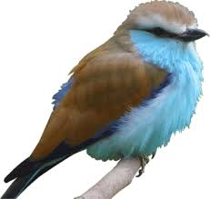
Artificial intelligence
The typical example of pattern recognition
Generate and test method (cf. trying to find a bird from a book)
0.1% success
Generate
Test
99.9% failure
Representations supporting
Models targeted at
Thinking, perception and action

Slide 10
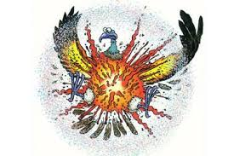
Artificial intelligence
The typical example of pattern recognition
Generate and test method (cf. trying to find a bird from a book)
0.1% success
Generate
Test
99.9% failure
Once you have a name for it, you can start talking about it, you have power over it
Symbolic labels give us power over concepts
The Rumpelstiltskin tale
« Once you can name something you have power over it »
Representations supporting
Models targeted at
Thinking, perception and action

Slide 11
Artificial intelligence
The right representation? Exemple of the farmer, fox, goose and grain
Fa
Fa
Fo
Fo
Go
Go
Gr
Gr
Normally 16 possibles, but some are impossible (someone gets eaten)
Representations supporting
Models targeted at
Thinking, perception and action

Slide 12
Artificial intelligence
The right representation? Exemple of the farmer, fox, goose and grain
Fa
Fa
Fo
Fo
Go
Go
Gr
Gr
Normally 16 possibles, but some are impossible (someone gets eaten)
By drawing as the right representation (a graph), it exposes the constraints
Constraints exposed by
Representations supporting
Models targeted at
Thinking, perception and action

Slide 13
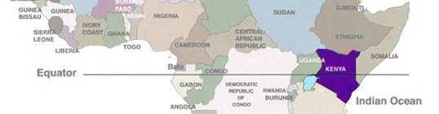
Artificial intelligence
How many countries are crossed by the equator in Africa ?
Follow line
Language
Visual system
Visual system
Language
Count
Constraints exposed by
Representations supporting
Models targeted at
Thinking, perception and action

Slide 14
Artificial intelligence
How many countries are crossed by the equator in Africa ?
Follow line
Language
Visual system
Visual system
Language
Count
Algorithms enabled by
Constraints exposed by
Representations supporting
Models targeted at
Thinking, perception and action

Slide 15
Artificial intelligence
Imagine you are running down the street with a bowling ball ?
… What will happen to you?
You can know the consequences, without having any prior experience !
Trivial is not simple. Warning on the confusion …
Some people think that ideas are only good if they are complicated
Simple ideas are usually the best and most powerful (Occam’s razor)
As there is wide controversies about AI (weak vs. strong, feasible vs. fake)
… we will only dwell in the world of machine learning.
But first let’s look at historical approaches of artificial intelligence
Algorithms enabled by
Constraints exposed by
Representations supporting
Models targeted at
Thinking, perception and action

Slide 16
Why learning ?
Some things computers do …
… That we can not
(Try beating a computer at PI decimals)
Some things we do almost instantly …
… That computer fails miserably
(Typical conversation with a computer)
60+ years of ongoing research in AI
(face recognition, content segmentation, etc…)

Slide 17
Artificial intelligence
So why developing and using AI in general?
Engineer « Building smarter programs »
Scientist « Build a computational account of intelligence »
1842: Lady Ada Lovelace, the first ever programmer
(even decades before computers even existed)
« The analytical engine has no pretentions to originate anything,
it can do whatever we know how to order it to perform »
1950s: Alan Turing - « the Turing test »
Marvin Minski - « Steps towards artificial intelligence »
1960s: Early dawn age (age of speculation)
Symbolic integration
ELIZA chatbot

Slide 18
ELIZA Program
The first ever implemented chatbot (1966)
Eliza emulates a Rogerian psychotherapist.
No intelligence whatsoever, but a lot of interesting tricks
Uses string substitution and keywords canned response
Beginning of the Natural Language Processing (NLP) field
Live demonstration
https://www.masswerk.at/elizabot/

Slide 19
Early dawn age: symbolic integration
Program of symbolic integration written by Joel Moses in 1967 at MIT
Apply safe transforms
Look table
Done?
Apply heuristics
Find problem
(1)
(2)
(3)
(A)
(B)
Intelligence vanish with explanation
Knowledge is power => Knowledge over knowledge is power
Problem solving by problem transformation (problem reduction)
The rise of goal trees and expert systems

Slide 20
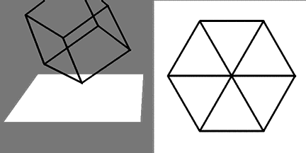
On complexity
Imagine you observe the path of an ant
Seems complicated … you could say the ant is extremely smart
You look closer, there are rocks that the ant is just avoiding
Complexity can be consequence of the environment not the program
Now imagine you are trying to understand this behavior
Notion of problem
dimensionality

Slide 21
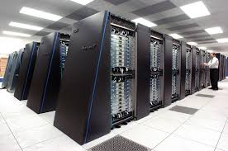
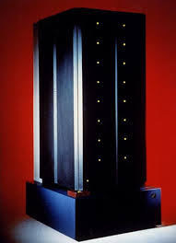
Now ? The Bulldozer age
Replacing intelligence by mass computing (parallel and HPC)
Deep blue

Slide 22
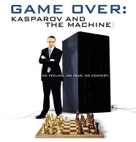
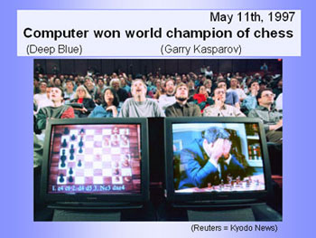
Games, Minmax and alpha-beta
Ex. DeepBlue beating Kasparov
Ways to play
Analysis/strategy/tactics ?=>? Move
If/Then rules => Pick the highest current move possible (still lame)
Look ahead and evaluate the situation (this requires a static value)
S = g(f1,f2,…,fn) = w1.f1+w2.f2+…+wn.fn = linear scoring polynomial
Brute force approach = evaluate the whole tree of possibles
… However 10^120 possible … leafs !
So the best way is to look ahead the most possible
And try to evaluate the highest number of leaves

Slide 23
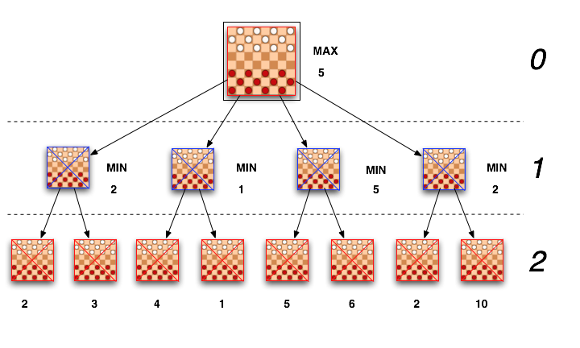
Games, Minmax and alpha-beta
A computer beats a chessmaster: Min-max algorithm
We have a fitness function and compute the chess tree
We see the tree from the view of the « Maximizing player »

Slide 24
Games, Minmax and alpha-beta
A computer beats a chessmaster: Min-max algorithm
We have a fitness function and compute the chess tree
We see the tree from the view of the « Maximizing player »
But the minimizing player alternates
So we do not choose the max … but the max of the mins ☺
Need to go as far down the tree as possible
14 levels separates a moron from a master !

Slide 25
Games, Minmax and alpha-beta
Alpha beta is layered over minmax to remove large parts of the tree
The idea is as soon we find a branch lower than our expected value
Stop evaluating the other sub-branches and try to go further down the other tree!
Problem of how deep can we go ? Use an insurance policy on level (d-1)
This idea is called progressive deepening
Deep blue = all this + parallel computing + books + uneven tree dev.
So deep blue intelligent ? Maybe … but mostly bulldozer intelligence
Remember to avoid overkill => eg. Ressource allocation = Constraints problem

Slide 26
Going machine learning
As we have discussed earlier …
Artificial intelligence was set to simulate intelligence
But this is mostly through symbolic and rule-based approaches
There is wide controversies about AI (weak vs. strong, feasible vs. fake)
Avoiding any debate, we will only discuss here machine learning.
Can we automatically learn parameters of an approximation
The most active field recently, and also very wide topics inside it
Artificial Intelligence (AI)
Any technique allowing machines to solve human tasks
Machine Learning (ML)
Bayesian
Learning inference models from examples
SVM
GMM
Neural Networks (NN)
Brain-inspired ML models
Deep Learning (DL)
Building (deep) hierarchies of NN representations

